Slide 1

SMART INDIA HACKATHON 2025
TITLE PAGE
Problem Statement ID – SIH25076
Problem Statement Title - AI-Based Farmer Query Support &Advisory System
Theme – Agriculture , Food Tech & Rural Development
PS Category - Software
Team ID - SRU_63
Team Name – Team 404 Not Found

Slide 2
IDEA TITLE
Team 404 Not Found
Proposed solution
Voice assistant supports regional languages for easy, hands-free interaction.
Farmers can ask questions verbally and receive instant spoken responses and they can also get text responses
Icon-based interface simplifies navigation for users with low literacy.
Each icon represents a key function like crop advice, market rates, or schemes.
Voice and icon inputs work together to guide users step-by-step.
Minimal text ensures accessibility across age groups and education levels.

Slide 3
TECHNICAL APPROACH
Team 404 Not Found
Technologies to be used –
PLATFORM ARCHETECHTURE :
Frontend : Built using HTML/CSS/JAVA SCRIPT For light weight performance
Backend: Built using PYTHON ,Node.js for requests
VOICE ASSISTANT INTEGRATION :
Voice Input : Used Web Speech API for browse-based input
Support local languages(English , Telugu , Hindi , Tamil , Malayalam , Kannada)

Slide 4
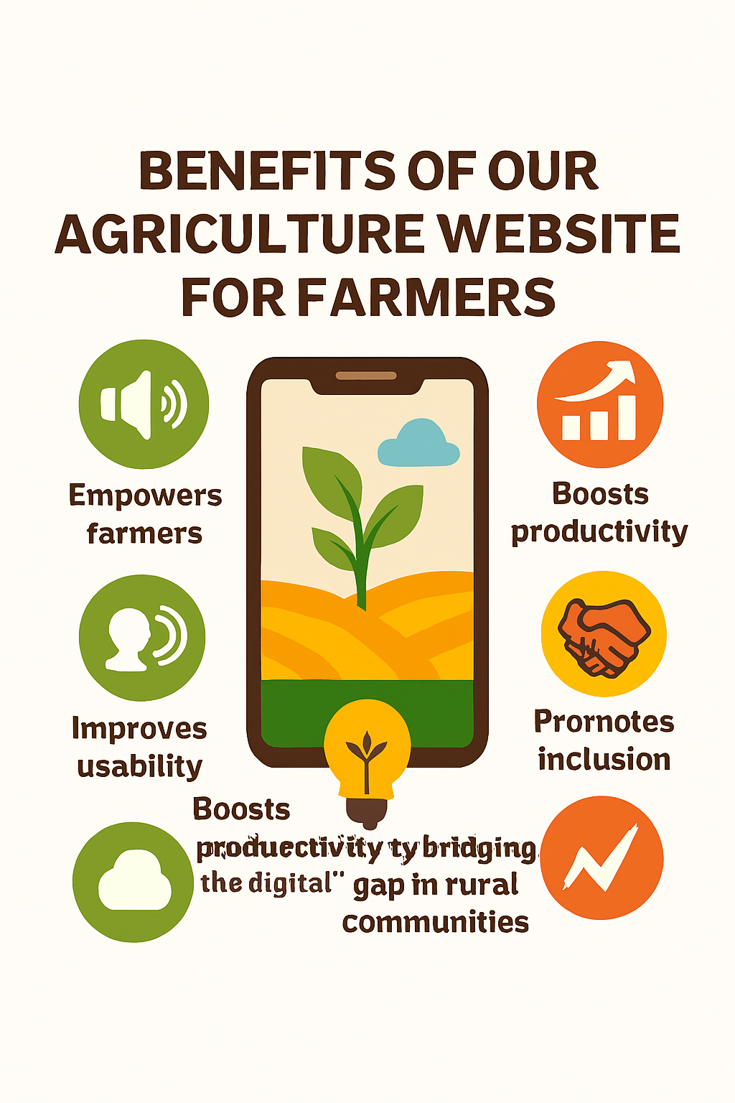
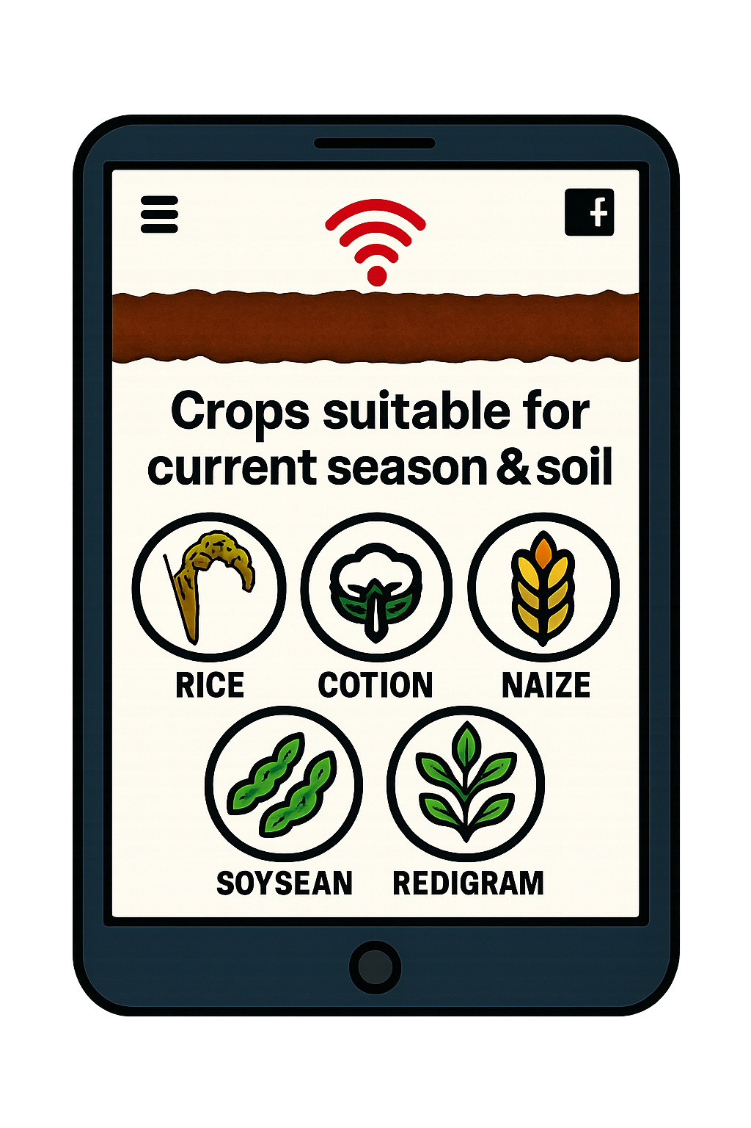
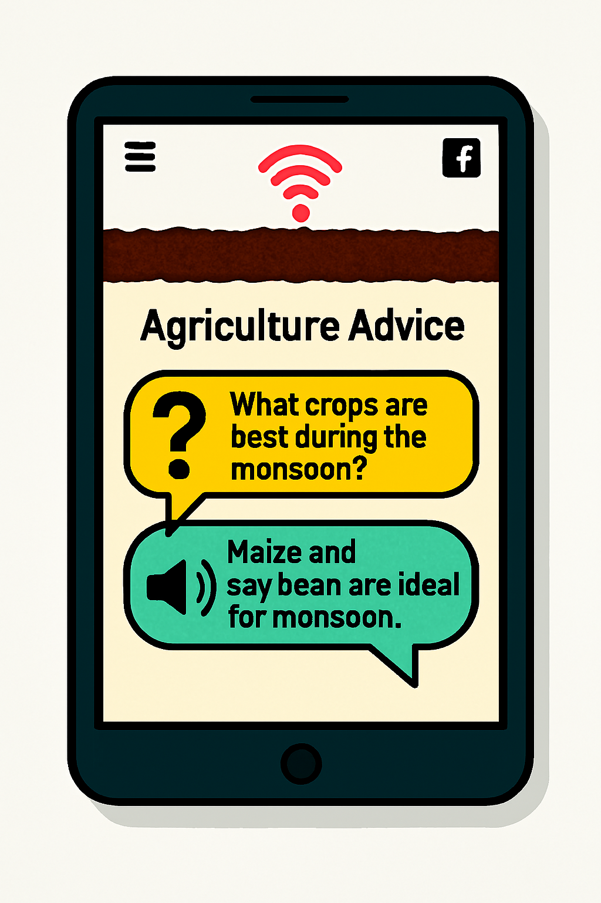
IMPACT AND BENEFITS
Team 404 Not found
Empowers farmers by giving them easy access to crop advice, market rates, and schemes through voice and icons.
Improves usability for non-literate users with simple visuals and spoken guidance.
Boosts productivity by helping farmers make faster, smarter decisions.
Promotes inclusion by bridging the digital gap in rural communities.
Goals Multilingual communicator ,voice and text based,input and output , acurate to context ,user friendly & easy accessibility

Slide 5
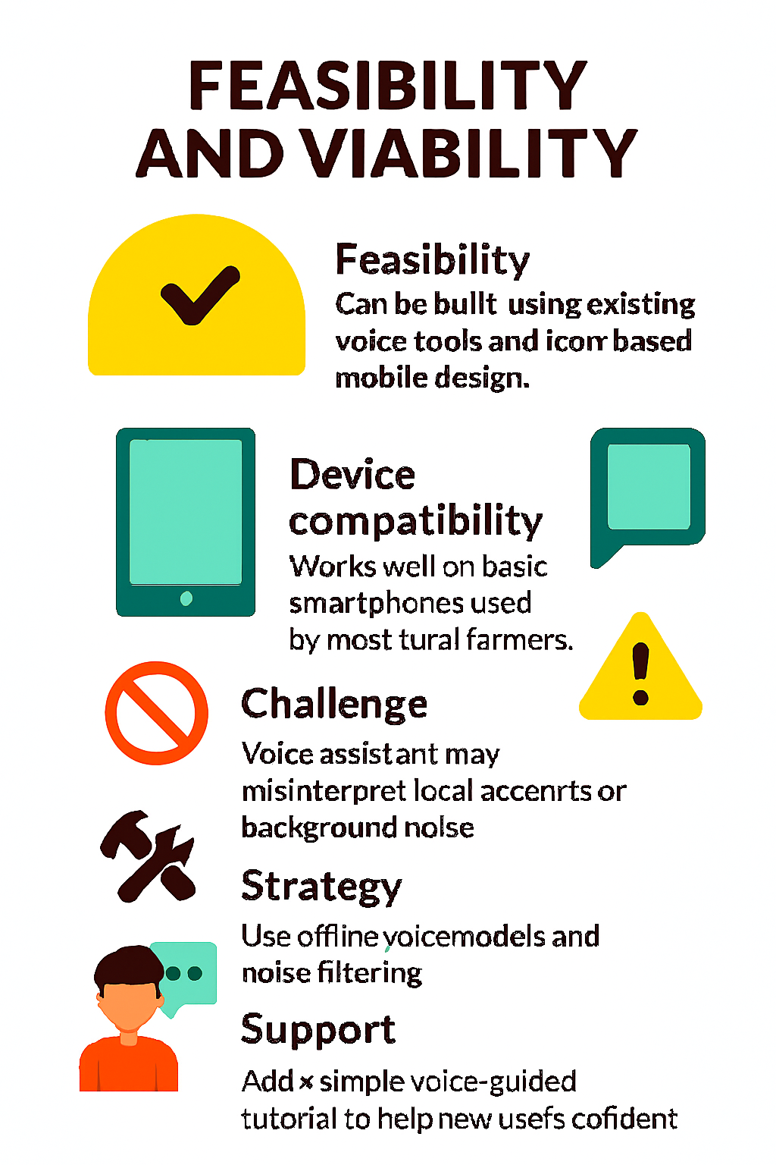
FEASIBILITY AND VIABILITY
Team 404 Not found
Feasibility: Can be built using existing voice tools and icon-based mobile design.
Device compatibility: Works well on basic smartphones used by most rural farmers.
Challenge: Voice assistant may misinterpret local accents or background noise.
Risk: Some users may hesitate due to low digital literacy or fear of tech.
Strategy: Use offline voice models and noise filters to improve accuracy.
Support: Add a simple voice-guided tutorial to help new users feel confident
Future Outcomes : Image Query , Market Trends , Translation

Slide 6
REFERENCES
I.
Team 404 Not found
Rehman, M. Z. U., Raghuvanshi, D., & Kumar, N. (2023). KisanQRS: A deep learning-based automated query-response system for agricultural decision-making. Computers and Electronics in Agriculture, 213, 108180.
Vanitha, V., Rajathi, N., & Prakash Kumar, K. (2023). AI-Based Agriculture Recommendation System for Farmers. In Computer Vision and Machine Learning in Agriculture, Volume 3 (pp. 91-103). Singapore: Springer Nature Singapore.
Godara , S., & Toshniwal, D. (2022). Deep Learning-based query-count forecasting using farmers’ helpline data. Computers and Electronics in Agriculture, 196, 106875.

